Slide 1
Genesis of Hurricane Julia (2010) from an African Easterly Wave
Stefan Cecelski¹ and Dr. Da-Lin Zhang
Department of Atmospheric and Oceanic Science, University of Maryland
1: Research is funded by NASA’s Earth and Space Science Fellowship (NESSF)

Slide 2
What is tropical cyclogenesis (TCG)?
The point at which a tropical disturbance over the ocean starts intensifying;
Genesis is also defined from the National Hurricane Center (NHC) when it declares a system a tropical depression (TD);
Once genesis takes place, the disturbance can sustain itself (and even intensify) through wind-induced surface heat exchange (WISHE)

Slide 3
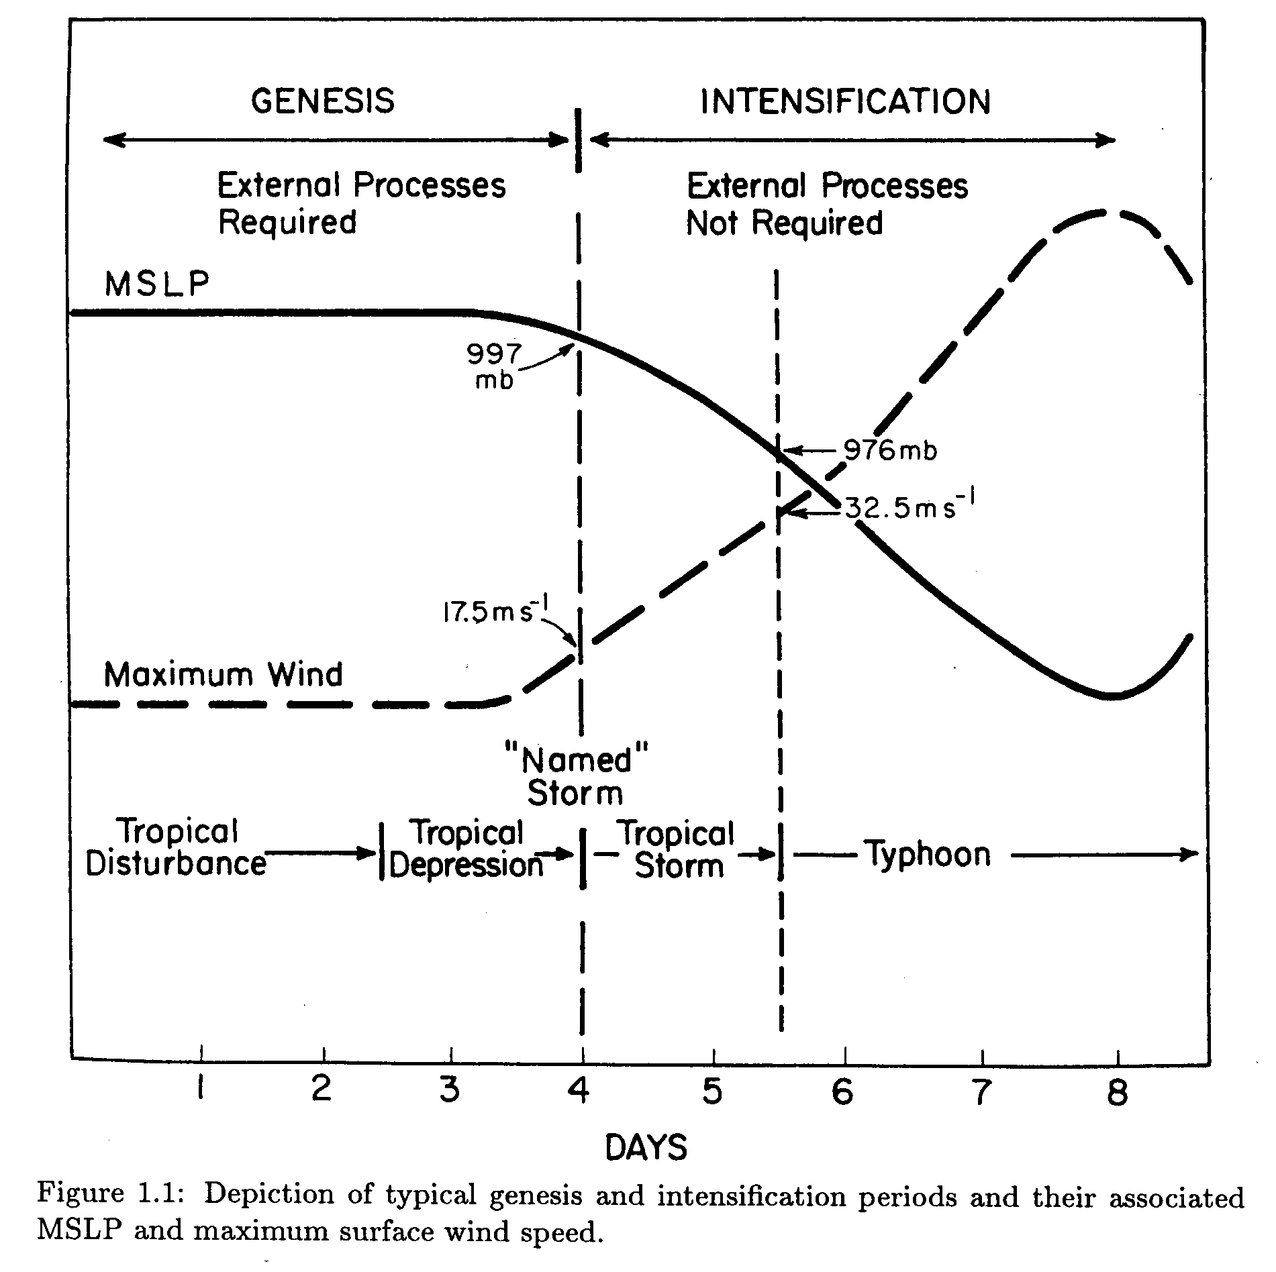
Zehr (1992)

Slide 4
Large-Scale Environmental Conditions
Weak vertical wind shear over the depth of the troposphere (between 850 and 200 hPa);
Sea-surface temperatures (SSTs) greater than 26°C;
Sufficient moisture in the lower and middle troposphere

Slide 5
The Role of the African Easterly Wave (AEW) in TCG
An AEW is a wave that propagates westward across Africa;
Latitudinal formation is typically confined between 5 and 20 N;
Cyclonic circulation is maximized between 850 and 500 hPa; a mid-troposphere phenomena
AEWs are the most common path way for TCG in the main development region of the North Atlantic basin
The AEW allows for a favorable environment for TCG;
Protects the developing disturbance from dry air, large vertical wind shears;
Provides a “sweet spot” for growth of a pre-genesis disturbance, the so-called marsupial paradigm (Dunkerton et al. 2009 and Montgomery 2010)

Slide 6
Vorticity Development during TCG: Two Major Theories
Top-Down Formation
Bottom-Up Formation
Low-level vorticity is spun up from the top down to the surface
A mesoscale cyclonic vortex is extended toward the surface via precipitation/evaporative cooling
Found to be ineffective in creating the near-surface circulation
Low-level cyclonic vorticity exists in large scales (meso-α) and is spun up and contracted
Convective elements (meso-β scale) enhance the cyclonic vorticity; the idea of a Vortical Hot Tower (VHT)
Meso-β features are thought to aggregate to create the low-level cyclonic vortex

Slide 7
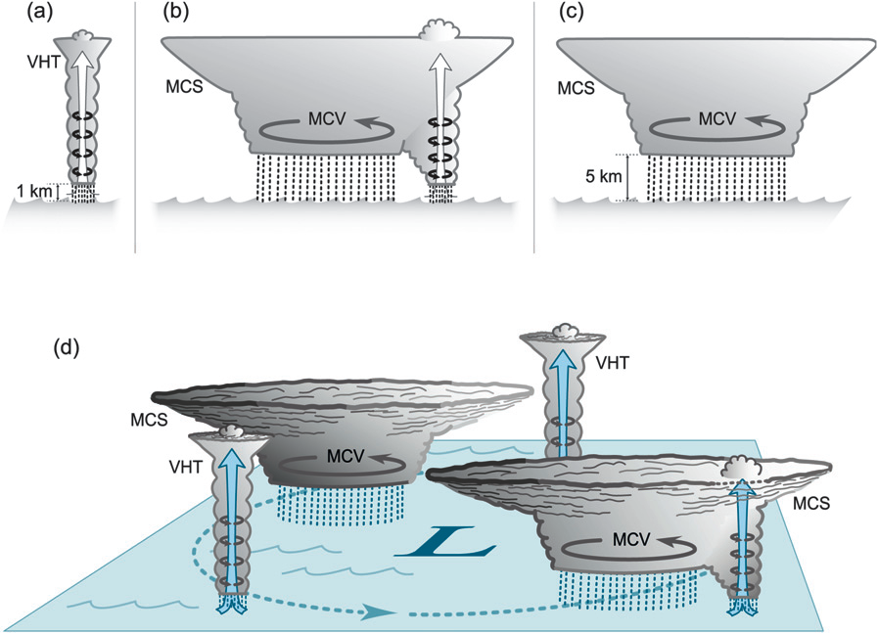
Figure from Houze, et. al (2009)
(a): An individual VHT that can help make an MCS. Vorticity of the low-levels is stretched via convergence in the updraft
(b): VHTs become apart of a longer-lived MCS, which forms a stratiform region from the weakening VHTs.
(c): Weakening stage of MCS, VHT formation ceases.
(d): Shows life-cycle of MCS from VHT to MCS.
MCV: Mesoscale Convective Vortex
MCS: Mesoscale Convective System
VHT: Vortical Hot Tower

Slide 8
Where my research fits in
The large-scale characteristics associated with TCG are well known…but what about the role of smaller features?
Features with horizontal lengths from 10 km to 500 km (meso-γ and meso-β structures); “Vortical hot towers”
Convection on the meso-γ and meso-β spatial scale is important for genesis via vorticity generation
Multi-scale interactions exist between smaller scale convective features and the larger scale environment

Slide 9
Methodology
Use the Weather and Research Forecasting (WRF) numerical weather prediction model to simulate Julia’s development
Due to limited observing networks, need some way to assess the dynamics at a high spatial resolution
WRF simulation is compared against the limited observations we have to validate its accuracy

Slide 10
Motivation
The genesis of Julia was not well anticipated
Introduced into the Tropical Weather Outlook (TWO) with a medium (30%) chance of formation only 18 h prior to transition in TD and a 70% chance of genesis 6 h prior to TCG (Tropcical Cyclone Report, Beven and Landsea)
Explore the meso-β development (vorticity generation)
What role does convection play for the development within the AEW?

Slide 11
Objectives
Examine the genesis of Julia from the merging of several meso-β-scale vortices within the AEW;
Study how deep convection, invigorated through a high θ_{e} and storm-relative helicity (SRH) environment, contributes to the development of the meso-β-scale vortices;
Show that the vorticity maxima (and related convection) lies on the critical level (latitude) Dunkerton, et al. 2009, the latitude where the wind speed equals the phase speed of the AEW)

Slide 12
WRF Model Set-up
NOAA Optimal Interpolation SSTs (shaded, degrees C), 700-hPa Streamlines (resting frame) from ERA-Interim for the initialization time of the WRF simulation.
Notes:
NOAA Optimal Interpolation SST data was used since Igor passed over a similar track shortly before Julia. As seen in the SST data, cooling is found south of the Cape Verde Islands where Igor passed over. These cooler SSTs were not resolvable by the coarser ERA grid, but were by the .25 degree OI data.

Slide 13
WRF Validation
TD
Average P_{MIN} error from observed was 1.67 hPa. Track errors had substantial more latitudinal error than longitudinal.
Notes:
The storm was slow to strengthen with most strengthening taking place after costal transition.

Slide 14
WRF Outgoing Longwave Radiation (OLR, shaded, white/gray low OLR) and 700-hPa wind barbs
METEOSAT-9 IR Imagery with satellite-derived winds
400-599 hPa (blue)
600-799 hPa (yellow)
800-950 hPa (green)
Julia
Notes:
Subjective analysis shows good agreement with the spatial distribution of clouds when compared to the METEOSAT-9 IR imagery. Comparing the wind fields from the 600-799 hPa layer (yellow barbs on LHS) with the 700 hPa WRF wind barbs, see a significantly more zonal component, associated with the AEJ to the north of the storm. This more zonal flow certainly could have suppressed the storm further south than the observed track.

Slide 15
Transition from AEW to Julia
925-hPa co-moving streamlines, relative vorticity (shaded) and MSLP (red contours, every 1 hPa). Black line represents hourly-based back-trajectory of vorticity center that becomes co-located with the AEW circulation center. The AEW trough axis at 3 times is superimposed, with the black-dashed line being the current time trough axis. The critical latitude is shown with a dotted line.
925-hPa Radar reflectivity (shaded) relative vorticity (contours), co-moving streamlines and the critical latitude (dashed line) 6 hours prior to 0600 UTC 12 Sept
How did it strengthen over the 6-hour period?

Slide 16
925-hPa Radar reflectivity (shaded), relative vorticity (contours), co-moving streamlines and critical latitude (dashed line)
925-hPa Theta-e (shaded), 0-3km Storm-relative helicity (contours), co-moving streamlines and critical latitude (dashed line)
Notes:
See high theta-e to the NW of the AEW center, where convection is invigorated or even re-initiated from remnant vorticity maxima. The CAPE in the center of the AEW is very small because of the typical thermodynamical structure of an AEW, with cooling below the mid-level vortex and warming aloft.

Slide 17
925-hPa Radar reflectivity (shaded), relative vorticity (contours), co-moving streamlines and critical latitude (dashed line)
925-hPa Theta-e (shaded), 0-3km Storm-relative helicity (contours), co-moving streamlines and critical latitude (dashed line)
Notes:
See high cape to the NW of the AEW center, where convection is invigorated or even re-initiated from remnant vorticity maxima. The CAPE in the center of the AEW is very small because of the typical thermodynamical structure of an AEW, with cooling below the mid-level vortex and warming aloft.

Slide 18
Concluding Remarks
While the AEW provides favorable forcing for convective development, merging of meso-β-scale vortices generated in rainbands accounts for the genesis of Julia;
High θ_{e} air to the north and west of the storm invigorates convection while ingestion of high sfc-3km SRH aids in cyclonic relative vorticity development at 925 hPa;
As hypothesized by Dunkerton, et al. 2009, the critical latitude provides a preferred region for amplification of meso-β development (their H1);
This low-level cyclonic vorticity development leads to genesis, both through convective enhancement and the critical latitude acting as an ‘attractor’ for meso-β cyclonic vortices

